Slide 1

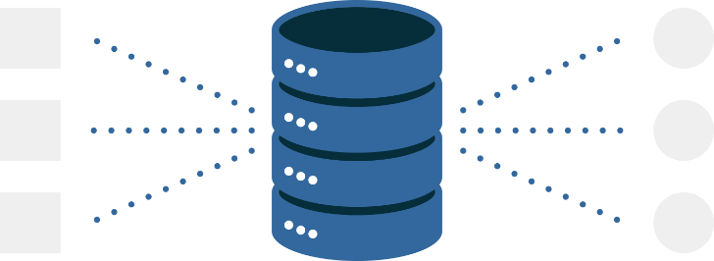
DeNormalization
Lecture 12
Fahad Maqbool
Department of Computer Science

Slide 2
Balance Between Good & Evil
De-normalization
Normalization
Too many tables
4+ Normal Forms
3rd Normal Form
2nd Normal Form
Data Cubes
1st Normal Form
Data Lists
Flat Table
One big flat file

Slide 3
What is DeNormalization?
It is not chaos, more like a “controlled crash” with the aim of performance enhancement without loss of information.
Normalization is a rule of thumb in DBMS, but in DSS ease of use is achieved by way of denormalization.
De-normalization comes in many flavors, such as combining tables, splitting tables, adding data etc., but all done very carefully.

Slide 4
What is DeNormalization?
Bringing “close” dispersed but related data items.
Query performance in DSS significantly dependent on physical data model.
Very early studies showed performance difference in orders of magnitude for different number de-normalized tables and rows per table.
The level of de-normalization should be carefully considered.

Slide 5
DeNormalization Improves Performance
De-normalization specifically improves performance by either:
Reducing the number of tables and hence the reliance on joins, which consequently speeds up performance.
Reducing the number of joins required during query execution, or
Reducing the number of rows to be retrieved from the Primary Data Table.

Slide 6
DeNormalization Guidelines
Carefully do a cost-benefit analysis (frequency of use, additional storage, join time).
Do a data requirement and storage analysis.
Weigh against the maintenance issue of the redundant data (triggers used).
When in doubt, don’t denormalize.

Slide 7
Dealing with the abundance of star schemas.
Fast access to time series data for analysis.
Fast aggregate (sum, average, etc.) results and complicated calculations.
Multidimensional analysis (e.g., geography) in a complex hierarchy.
Dealing with few updates but many join queries.

Slide 8
Five DeNormalization Principles
Collapsing Tables.
Two entities with a One-to-One relationship.
Two entities with a Many-to-Many relationship.
Splitting Tables (Horizontal/Vertical Splitting).
Pre-Joining.
Adding Redundant Columns (Reference Data).
Derived Attributes (Summary, Total, Balance etc).

Slide 9
Collapsing Tables
ColA
ColB
denormalized
ColA
ColB
ColC
normalized
ColA
ColC
Reduced storage space.
Reduced update time.
Does not changes business view.
Reduced foreign keys.
Reduced indexing.

Slide 10
Splitting
Table
Table_v1
Table_v2
ColA
ColB
ColC
ColA
ColB
ColA
ColC
Vertical Split
Table_h1
Table_h2
ColA
ColB
ColC
ColA
ColB
ColC
Horizontal split

Slide 11
Horizontal Splitting
Breaks a table into multiple tables based upon common column values. Example: Campus specific queries.
GOAL
Spreading rows for exploiting parallelism.
Grouping data to avoid unnecessary query load in WHERE clause.

Slide 12
Horizontal Splitting: Advantages
Enhance security of data.
Organizing tables differently for different queries.
Graceful degradation of database in case of table damage.
Fewer rows result in flatter B-trees and fast data retrieval.

Slide 13
Vertical Splitting
Infrequently accessed columns become extra “baggage” thus degrading performance.
Very useful for rarely accessed large text columns with large headers.
Header size is reduced, allowing more rows per block, thus reducing I/O.
Splitting and distributing into separate files with repeating primary key.
For an end user, the split appears as a single table through a view.

Slide 14
Pre Joining
Identify frequent joins and append the tables together in the physical data model.
Generally used for 1:M such as master-detail. RI is assumed to exist.
Additional space is required as the master information is repeated in the new header table.

Slide 15
Pre Joining
Master
Sale_ID
Sale_date
Sale_person
normalized
1
M
Tx_ID
Sale_ID
Item_ID
Item_Qty
Sale_Rs
Detail
Tx_ID
Sale_ID
Sale_date
Sale_person
Item_ID
Item_Qty
Sale_Rs
denormalized

Slide 16
Pre Joining
Typical of Market basket query
Join ALWAYS required
Tables could be millions of rows
Squeeze Master into Detail
Repetition of facts. How much?
Detail 3-4 times of master

